Slide 1
How to configure and use
Multi Step Match
For matching bibliographic records via multiple fields
Yoel Kortick
Senior Librarian

Slide 2
Agenda
Introduction
The specific use case here
The configuration
Our sample records which we will match against
Confirming that the Multi Step Match works
2

Slide 3
Introduction

Slide 4
Introduction
The Multi Step Match Configuration allows institutions to use multiple match routines when Alma “looks for” matching records either via an import profile or in the Metadata Editor.
When the institution decides which match routine to use it is often difficult to select the most appropriate match routine. This is because in some case one routine might be appropriate while in other case another routine might be appropriate.
In other words, different routines might be suitable for different situations.

Slide 5
Introduction
The multiple match methods are run in the order defined in the table “Multi Step Match Configuration” at “Configuration > Resources > General > Multi Step Match Configuration”.
The matching process is as following:
Alma attempts to find a match using the first match method.
If a match was found, the record is considered as a match and the process stops.
If no match was found, then Alma attempts matching using the next match method.
The process continues until either a match was found, or no additional match methods have been defined.
In addition to this presentation see also Multi Step Match Configuration.

Slide 6
The specific use case here

Slide 7
The specific use case here
In our example
  For non serials we want to
    First have Alma “look for” a matching record using match method “035 (Other System Identifier) Match Method”
    If no match is found via “035 (Other System Identifier) Match Method” then we want Alma to use “ISBN Match Method (exact subfield match)”
    If no match is found via “ISBN Match Method (exact subfield match)” then we want Alma to use “LCCN Match Method”
  For serials we want to
    First have Alma “look for” a matching record using match method “035 (Other System Identifier) Match Method”
    If no match is found via “035 (Other System Identifier) Match Method” then we want Alma to use “ISSN Match Method (exact subfield match)”
    If no match is found via “ISSN Match Method (exact subfield match)” then we want Alma to use “LCCN Serial Match Method”

Slide 8
The configuration

Slide 9
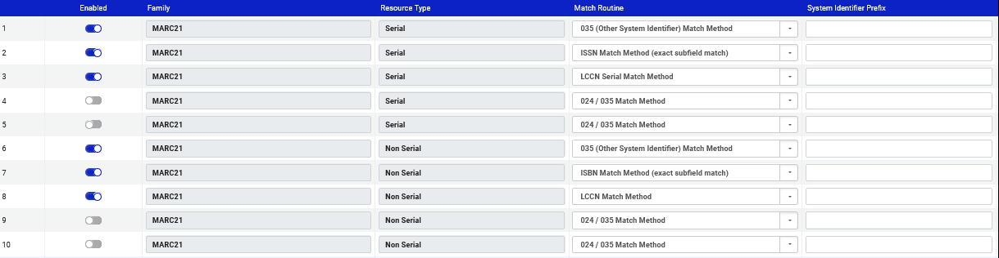
The configuration
At “Configuration > Resources > General” we will configure “Multi Step Match Configuration” as follows
Three activated match routines for Serials (will be used in this order)
Three activated match routines for Non Serials (will be used in this order)

Slide 10
The configuration
As described at Configuring Other Settings, if we want to use the Multi Step Match when looking for matches in the Metadata Editor then we need to define as follows in “Configuration > Resources > General > Other Settings” :
com.exlibris.repository.mms.match.MultiStepMatch
for
  serial_match_profile
  non_serial_match_profile

Slide 11
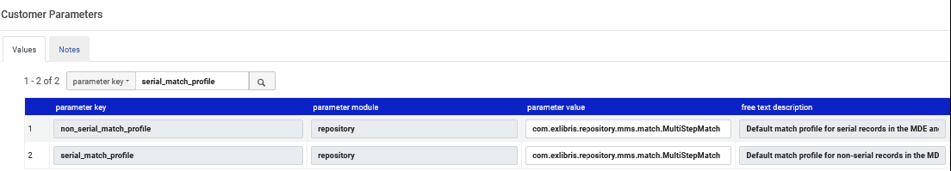
The configuration
Here are our definitions in “Configuration > Resources > General > Other Settings”

Slide 12
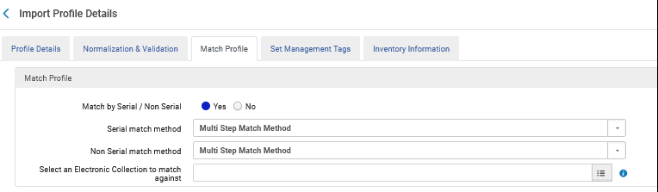
The configuration
As described at Managing Import Profiles Match Methods - Explanations and Examples, if we want to use the Multi Step Match in an Import Profile then we need to define as follows:

Slide 13
Our sample records which we will match against

Slide 14
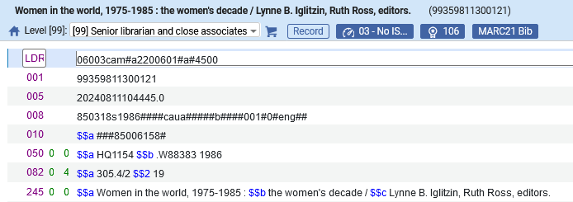
Our sample records which we will match against
This non serial record (99359811300121) exists in Alma and does not have the foillowing
  035 (System Control Number)
  020 (ISBN).
It does have a
  010 (LCCN).
Thus, it cannot match by
  035 (Other System Identifier) Match Method
  ISBN Match Method (exact subfield match)
It can match
  LCCN Match Method

Slide 15
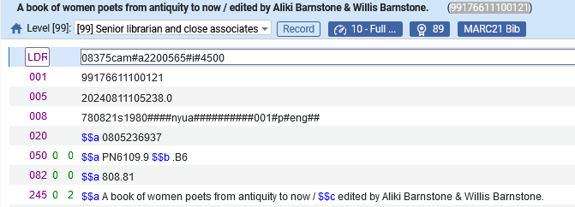
Our sample records which we will match against
This non serial record (99176611100121) exists in Alma and does not have a
  035 (System Control Number)
  010 (LCCN).
It does have a
  020 (ISBN).
Thus, it cannot match by
  035 (Other System Identifier) Match Method
  LCCN Match Method
It can match by
  ISBN Match Method (exact subfield match)

Slide 16
Confirming that the Multi Step Match works

Slide 17
Confirming that the Multi Step Match works
At this stage:
  We have defined that the Multi Step Match will work in the metadata editor
    We defined this via definitions in “Configuration > Resources > General > Other Settings” for parameters “serial_match_profile” and “non_serial_match_profile”).
  We have a record in Alma which has a 010 and no 035 or 020 (MMSID 99359811300121)
  We have a record in Alma which has a 020 and no 035 or 010 (MMSID 99176611100121)

Slide 18
Confirming that the Multi Step Match works
We will now have a new record with a 010 field like this existing record in the Metadata Editor and check for matches
Example One

Slide 19
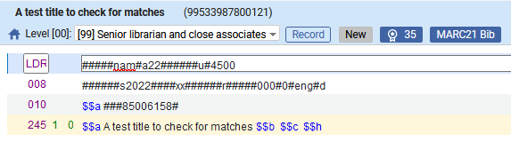
Confirming that the Multi Step Match works
Here is our record with the matching 010
Example One

Slide 20
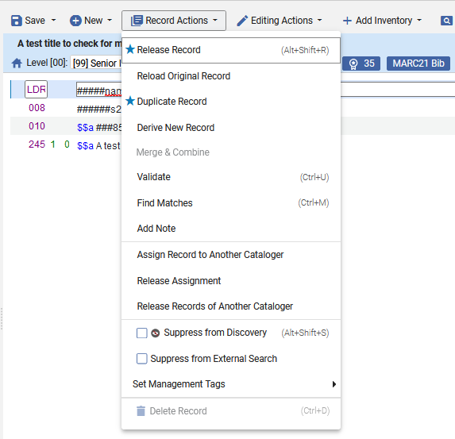
Confirming that the Multi Step Match works
We will check for matches
Example One

Slide 21
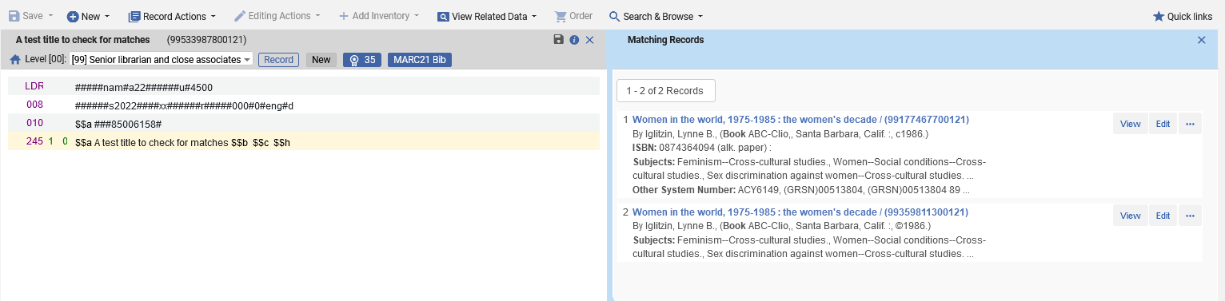
Confirming that the Multi Step Match works
Alma finds two matches
Example One

Slide 22
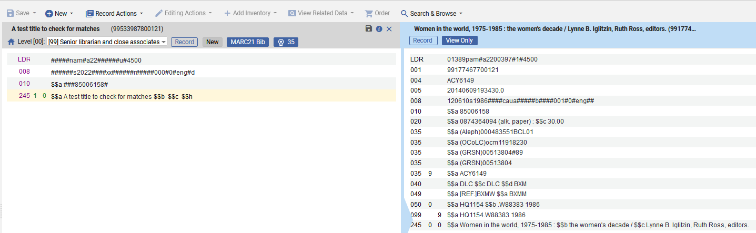
Confirming that the Multi Step Match works
The first matching record has a matching 010 LCCN
Example One

Slide 23
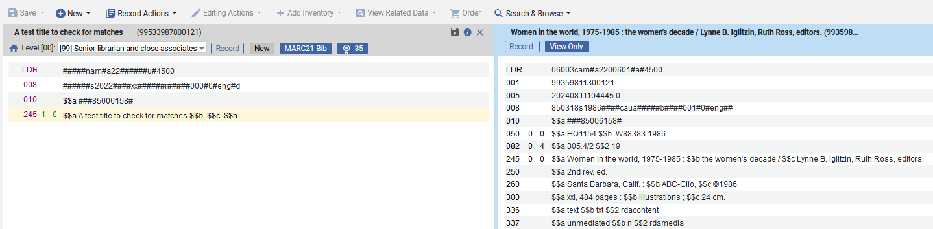
Confirming that the Multi Step Match works
The second matching record has a matching 010 LCCN
Example One

Slide 24
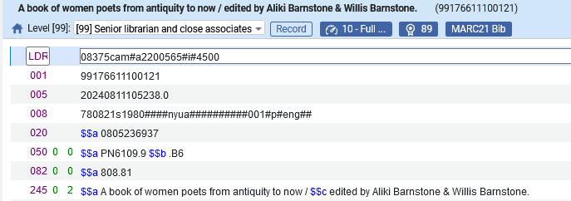
Confirming that the Multi Step Match works
We will now have a new record with a 020 field like this existing record in the Metadata Editor and check for matches
Example Two

Slide 25
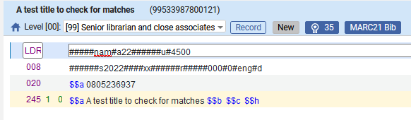
Confirming that the Multi Step Match works
Here is our record with the matching 020.
Example Two

Slide 26
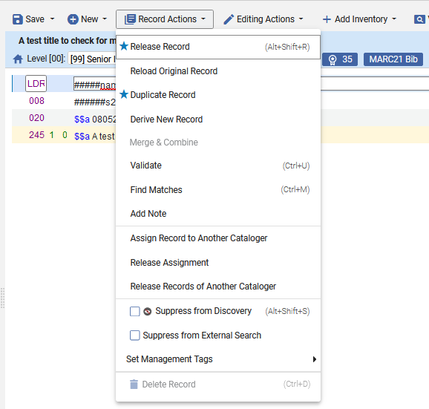
Confirming that the Multi Step Match works
We will check for matches
Example Two

Slide 27
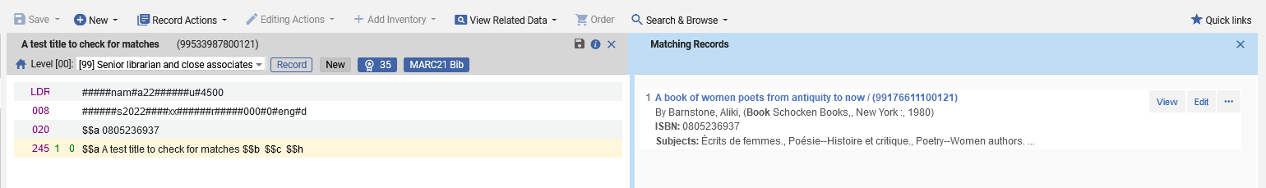
Confirming that the Multi Step Match works
Alma finds a match
Example Two

Slide 28
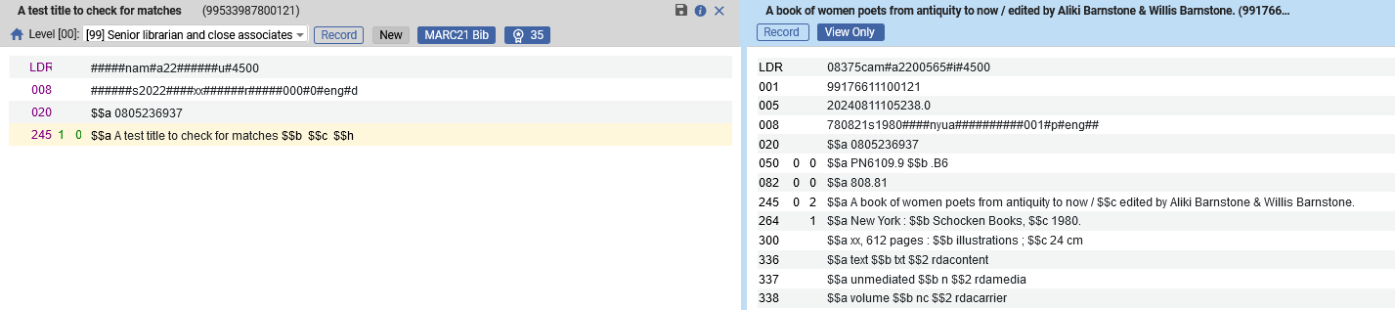
Confirming that the Multi Step Match works
The matching record has a matching 020 ISBN
Example Two

Slide 29
Confirming that the Multi Step Match works
We can now confirm that the Multi Step Match successfully worked.
One match routine was able to match
  Once on the 010 (when there was not a 020 or 035 in the record)
  Another time on the 020 (when there was not a 010 or 035 in the record)

Slide 30
Thank You

